Slide 1

Object-Oriented Programming in Python
Goldwasser and Letscher
Chapter 2
Getting Started in Python
Terry Scott
University of Northern Colorado
2007 Prentice Hall

Slide 2
Introduction: Chapter 2 Topics.
Python interpreter.
Using objects: list example.
str, tuple, int, long, and float.
Type conversion.
Calling functions.
Python modules.
Expressions.
Source code files.
Case study: strings and lists.

Slide 3
Python
Download Python at: http://www.python.org
IDLE: Integrated Development Environment.
In IDLE an entered statement is immediately executed.
IDLE prompt: >>>

Slide 4
List Class
Creating an empty list:
>>> x = list()
>>> x = [ ]
Creating a non-empty list:
>>> listcolors = ['red', 'orange', 'yellow', 'green', 'blue']
>>> groceries = [ ]
>>> groceries
[ ]
Next slide shows a representation of what the previous execution looks like in memory.

Slide 5
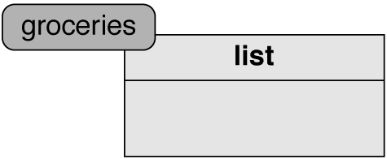
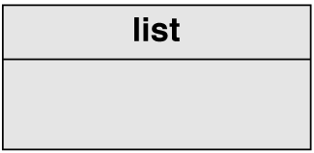
Creating Empty List and Assigning Empty List to groceries

Slide 6
Adding an Item to Groceries
>>> groceries.append('bread')
groceries is the object.
append is a method in the class. It is a mutator.
'bread' is a parameter.
Many of the operations will have this form.
Below shows how groceries has changed.
>>> groceries
['bread']

Slide 7
Errors
>>> groceries.append(bread)
Traceback (most recent call last):
File "stdin>", line 1, in –toplevel-
NameError: name 'bread' is not defined
>>> groceries.append( )
Traceback (most recent call last):
File "stdin>", line 1, in –toplevel-
TypeError: append() takes exactly one argument (0 given)

Slide 8
Inserting an Item Into a List
>>> waitlist = list()
>>> waitlist.append('Kim')
>>> waitlist.append('Eric')
>>> waitlist.append('Andrew')
>>> waitlist
['Kim', 'Eric', 'Andrew']
>>> waitlist.insert(1, 'Donald')
>>> waitlist
['Kim', 'Donald', 'Eric', 'Andrew']

Slide 9
Remove: Another List Mutator Method
>>> waitlist = ['Kim', 'Donald', 'Eric', 'Andrew']
>>> waitlist.remove('Eric')
>>> waitlist
['Kim', 'Donald', 'Andrew']
>>> #removes 'Eric' from the list.

Slide 10
Remove: Another Mutator Method (continued)
>>> waitlist
['Rich', 'Elliot', 'Alan', 'Karl', 'Alan', 'William']
>>> waitlist.remove('Alan')
>>> waitlist
['Rich', 'Elliot', 'Karl', 'Alan', 'William']
>>> #removes first occurrence of 'Alan'
>>> waitlist.remove('Stuart')
Traceback (most recent call last):
File "stdin>", line 1, in –toplevel-
ValueError: list.remove(x): x not in list

Slide 11
Count: A Method That Returns a Value
>>> groceries = ['bread','milk','cheese','bread']
>>> groceries.count('bread')
2
>>> groceries.count('milk')
1
>>> groceries.count('apple')
0
>>> #can assign return value to an identifier
>>> numLoaves = groceries.count('bread')
>>> print numloaves
2

Slide 12
Copying a List
>>> favoriteColors =['red','green','purple','blue']
>>> #making a copy of a list
>>> primaryColors = list(favoriteColors)
>>> primaryColors.remove('purple')
>>> favoriteColors
['red','green','purple','blue']
>>> primaryColors
['red','green','blue']

Slide 13
Range: Method that Returns a List
range(start, end, increment) – returns list of integer values from start, adding increment value to obtain next value up to but not including end.
  If you specify one parameter (i.e., range(5)), then start = 0, end = 5, and increment = 1.
  If you specify two parameters (i.e., range(23, 28)), then start = 23, end = 28, and increment = 1.
  If you specify three parameters (i.e., range(100, 130,4)), start = 100, end = 130, and increment = 4

Slide 14
Range Examples
>>> range(5)
[0, 1, 2, 3, 4]
>>> range(23, 28)
[23, 24, 25, 26, 27]
>>> range(100, 130, 4)
[100, 104, 108, 112, 116, 120, 124, 128]
>>> range(8, 3, -1)
[8, 7, 6, 5, 4]

Slide 15
Operators: Indexing(retrieving)
Some behaviors occur so often that Python supplies a more convenient syntax.
>>> contestants=['Gomes','Kiogora','Tergat', 'Yego']
>>> contestants[2]
'Tergat'

Slide 16
Operators: Indexing(replacing)
>>> groceries = ['cereal', 'milk', 'apple']
>>> groceries[1] = 'soy'
>>> groceries
['cereal', 'soy', 'apple']

Slide 17
Indexing With Negative Indices
>>> contestants=['Gomes','Kiogora','Tergat', 'Yego']
>>> contestants[-1]
'Yego'
>>> contestants[-4]
'Gomes'
>>> contestants[-2]
'Tergat'

Slide 18
Help
When in Idle using help:
  help(list)
  help(list.insert)
  help(any class or class method)
help() can enter help regime
  type items after help prompt. (help> )
  typing modules will list all modules.
  ctrl D exits help.

Slide 19
Pop Method: Mutator Method
>>> #if no parameter specified removes last
>>> #item and returns that value
>>> groceries = ['salsa','pretzels','pizza','soda']
>>> groceries.pop()
'soda'
>>> groceries
['salsa','pretzels','pizza']

Slide 20
Pop Method (continued)
>>> With parameter specified it removes the
>>> item at that index and returns it.
>>> waitlist = ['Kim', 'Donald', 'Grace', 'Andrew']
>>> toBeSeated = waitlist.pop(0)
>>> waitlist
['Donald', 'Grace', 'Andrew']
>>> toBeSeated
'Kim'

Slide 21
Three More Mutators: extend
>>> #extend is similar to append but adds a
>>> #list to end of a list instead of an element.
>>> groceries = ['cereal', 'milk']
>>> produce = ['apple', 'orange', 'grapes']
>>> groceries.extend(produce)
>>> groceries
['cereal', 'milk', 'apple', 'orange', 'grapes']
>>> produce
['apple', 'orange', 'grapes']

Slide 22
Three More Mutators (continued): reverse and sort
>>> groceries = ['cereal', 'milk', 'apple', 'orange', 'grapes']
>>> groceries.reverse()
>>> groceries
['grapes', 'orange', 'apple', 'milk', 'cereal']
>>> groceries.sort()
['apple', 'cereal', 'grapes', 'milk', 'orange']

Slide 23
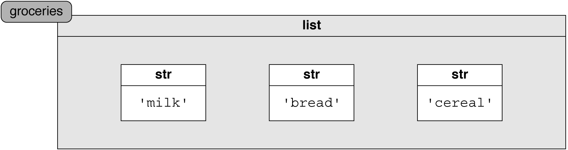
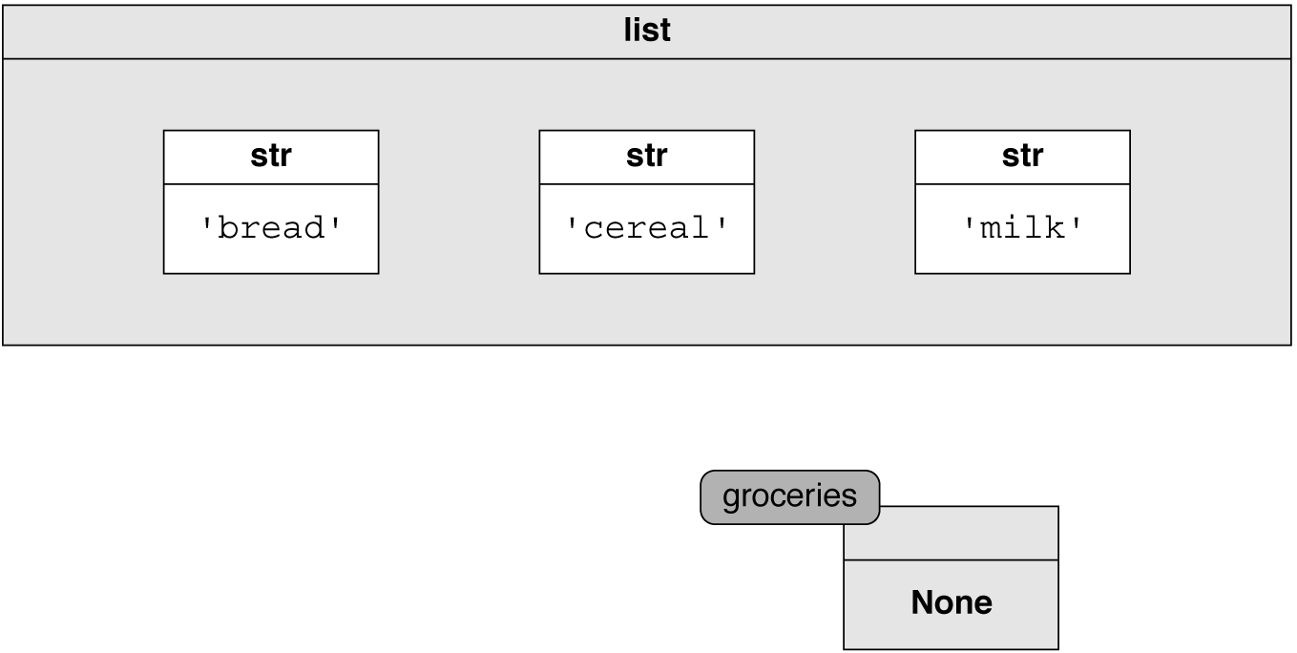
Sort Method: Sorts in Place, Doesn't Return a Value
groceries = ['milk', 'bread', 'cereal']
groceries =groceries.sort() #sort does not
#return a value.

Slide 24
Additional List Assessors
>>> waitlist = ['Kim', 'Donald', 'Grace', 'Andrew']
>>> len(waitlist)
4
>>> 'Michael' in waitlist
False
>>> 'Grace' in waitlist
True

Slide 25
Additional List Assessors (continued)
>>> waitlist = ['Kim', 'Donald', 'Grace', 'Andrew']
>>> #What position is 'Donald'?
>>> waitlist.index('Donald')
1
>>> #Make certain name is in list else error
>>> waitlist.index('Michael')
Traceback (most recent call last):
File "stdin>", line 1, in –toplevel-
ValueError: list.remove(x): x not in list

Slide 26
Additional List Assessors (continued)
>>> #Index only finds the first Alan
>>> waitlist = ['Rich','Elliot','Alan','Karl','Alan']
>>> waitlist.index('Alan')
2
>>> #Index can have a 2nd parameter that tells
>>> #where to start looking on the list
>>> waitlist.index('Alan', 3)
4

Slide 27
Additional List Assessors (continued)
>>> waitlist = ['Rich','Elliot','Alan','Karl','Alan']
>>> first = waitlist.index('Alan')
>>> second=waitlist.index('Alan',first + 1)
4
>>>
>>> #can have third parameter that is a
>>> #value for the stop index in the list
>>> #waitlist('name', start, stop)

Slide 28
Other Operators
Comparison operators
A==B True only if the two lists are exactly equal.
A!=B True if the lists differ in anyway.

Slide 29
Other Operators
>>> monthly = [ 0] * 12
>>> monthly
[0, 0, 0, 0, 0, 0, 0, 0, 0, 0, 0, 0]
>>> produce = ['apple', 'orange', 'broccoli']
>>> drygoods = ['cereal', 'bread']
>>> groceries = produce + drygoods
>>> groceries
['apple', 'orange', 'broccoli', 'cereal', 'bread']

Slide 30
List Modifying Methods
Syntax | Semantics
data.append(val) | add val to end of data list.
data.insert(i, val) | inserts val after first i elements in data list.
data.extend(otherlist) | appends otherlist to end of data list.
data.remove(val) | removes first occurrence of val in data list.
pop() | removes and returns last element from data list.

Slide 31
List Modifying Methods (continued)
Syntax | Semantics
data.pop(i) | removes and returns element with index i in data list.
data[i] = val | replaces element at index i in data list with val.
data.reverse() | reverses order of data list elements.
data.sort() | Sorts data list into increasing order.

Slide 32
List Methods Returning a Value
Syntax | Semantic
len(data) | return current length of data list.
data[i] | returns element at index i from data list.
val in data | Returns True if val in data list else False.
data.count(val) | returns number of occurrences of val in data list.
data.index(val) | returns index of earliest occurrence of val in data list.

Slide 33
List Methods Returning a Value (continued)
Syntax | Semantics
data.index(val, start) | same as previous index method except it starts looking at start rather than at start of data list.
data.index(val, start, stop) | same as above except stops just short of stop index.
dataA == dataB | Returns True if contents of dataA are pairwise identical with contents of dataB, else False.

Slide 34
List Methods Returning a Value (continued)
Syntax | Semantic
dataA != dataB | Returns True if contents not pairwise identical else False.
dataA <= dataB | Returns True if dataA is lexicographically (dictionary order) less than dataB, else False.

Slide 35
Lists Generating a New List (continued)
Syntax | Semantics
data[start:stop] | Return new list that is a “slice” of the original. It includes elements from start, up to but not including stop.
data[start:stop:step] | same as slice method above except now stepsize is whatever the step variable is.

Slide 36
Lists Generating a New List (continued)
Syntax | Semantics
dataA + dataB | Generates a third list that is dataB items added to the end of dataA. 'ABC' + 'DEF' = 'ABCDEF'
data * k | Generates a new list of data items repeated k times. 'ABC' * 3 becomes 'ABCABCABC'
dataA += dataB | dataA becomes dataA with dataB added to the end. This is the same as dataA = dataA + dataB
data *= k | data becomes data k times. This is the same as data = data * k

Slide 37
List, Tuple, and Str
Lists are mutable meaning that they can be changed.
Other sequence types are tuple and str.
  tuples use parentheses ( ) around the items separated by commas. They are immutable (not changeable)
  str – enclosed in single quotes or double quotes. Strings are also immutable.
  Many operations are the same for these classes. Obviously list operations where the list is changed are not possible with tuples and strings.

Slide 38
Str Class
Strings are immutable – not changeable.
Remember help(str) can give string methods.
str() creates an empty string. Can also assign using: strValue = ''.
String Literals (constants) are enclosed in single quotes or double quotes.
A \n causes a new line. The \ is sometimes called the quote character so that instead of n we get the new line character.

Slide 39
Behaviors Common to Lists and Strings
>>> greeting = 'Hello'
>>> len(greeting)
5
>>> greeting[1]
'e'

Slide 40
Behaviors Common to Lists and Strings (continued)
>>> greeting = 'Hello'
>>> greeting[0] = 'J'
Traceback (most recent call last):
File "<stdin>", line 1, in –toplevel-
TypeError: object does not support item assignment
>>> #Str is immutable. Can't change a string.

Slide 41
Behaviors Common to Lists and Strings (continued)
>>> #called slicing
>>> alphabet = 'abcdefghijklmnopqrstuvwxyz'
>>>alphabet[4:10]
'efghij'
>>> #default for 1st number is beginning of string.
>>> alphabet[:6]
'abcdef'

Slide 42
Behaviors Common to Lists and Strings (continued)
>>> alphabet = 'abcdefghijklmnopqrstuvwxyz'
>>> #no 2nd number then stop is end of string.
>>> alphabet[23:]
'xyz'
>>> #Third number is the step size which is
>>> #1 if the third value is not present.
>>> alphabet[9:20:3]
'jmps'

Slide 43
Behaviors Common to Lists and Strings (continued)
>>> musing='The swallow may fly south with'
>>> 'w' in musing
True
>>> 'ow ma' in musing
True
>>> 'South' in musing
False

Slide 44
Behaviors Common to Lists and Strings (continued)
>>> musing='Swallow may fly south with the sun'
>>> musing.count('th')
3
>>> musing.index('th')
23
>>> musing.index('ow ma')
5

Slide 45
Behaviors Common to Lists and Strings (continued)
Lexigraphic order (dictionary order). Check for lexigraphic order and return True or False.
String comparison
  == equality test. True if strings exactly the same.
  != inequality test. Do strings differ in some way.
  < left operand is less than right operand.
  <= left operand is less than or equal to right operand.
  > left operand is greater than right operand.
  >= left operand is greater than or equal to right operand.

Slide 46
String Methods not a Part of Lists.
>>> formal = 'Hello. How are you?'
>>> informal = formal.lower( )
>>> screaming = formal.upper( )
>>> formal
'Hello, How are you?'
>>> informal
'hello, how are you?'
>>> screaming
'HELLO, HOW ARE YOU?'

Slide 47
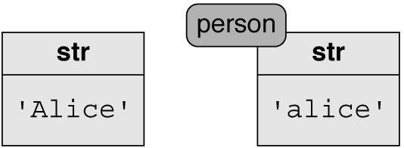
lower() Method: Before and After
>>> person = 'Alice'
>>> person = person.lower()

Slide 48
str Methods That Convert Between Strings and a List of Strings
s.split() : returns a list of strings obtained by splitting s into pieces that were separated by whitespace.
s.split(sep) : same as above except splits on sep string.
s.join(stringList) : returns a string that is the concatenation of the stringList items joined with the string s.

Slide 49
Split Method: Converts a str to a list
>>> request = 'eggs and milk and apples'
>>> request.split( )
['eggs', 'and', 'milk', 'and', 'apples']
>>> request.split('and')
['eggs ', ' milk ', ' apples']
>>> request.split(' and ')
['eggs', 'milk', 'apples']

Slide 50
Join Method: Converts a list to a str
>>> guests = ['John', 'Mary', 'Amy', 'Frank']
>>> ' and '.join(guests)
'John and Mary and Amy and Frank'

Slide 51
Unique String Methods
Syntax | Semantics
s.isalpha() | True if s is all alphabetic else False.
s.isdigit() | True if s is all digits else False.
s.isspace() | True if s is all white spaces else False.
s.islower() | True if s is all lower case else False.
s.isupper() | True if s is all upper case else False.

Slide 52
Unique String Methods (continued)
Syntax | Semantics
s.lower() | Returns s as all lower case.
s.upper() | Returns s as all upper case.
s.capitalize() | Returns s with first word capitalized.
s.center(num) | Returns s centered in width num.
s.ljustify(num) | Returns s left justified in width num.

Slide 53
Unique String Methods (continued)
Syntax | Semantics
s.rjustify(num) | Returns s right justified in width num.
s.strip() | Returns s with left and right white spaces removed.
s.strip(chars) | Returns s with left and right chars removed.
s.replace(old,new) | Returns new string with old replaced by new.

Slide 54
Tuple Methods
>>> skyBlue = (136, 207, 236)
Tuples are immutable (not changeable)
Tuples similar to lists but uses ( ) rather than [ ]. Also lists are mutable.
help(tuple) – get tuple methods.
Any methods for lists that don't change the list are also available for tuples.

Slide 55
Methods Same for Lists, Tuples, and Strings
Syntax | Semantics
len(s) | Returns the length of s.
s[i] | Returns item at i index
pattern in s | Returns True if pattern in s else False.
s.count(pattern) | Returns how many times pattern occurs in s.

Slide 56
Methods Same for Lists, Tuples, and Strings (continued)
Syntax | Semantics
s.find(pattern,start) | Returns index position of pattern in s beginning at start. Start default is 0. Not found return -1.
s.rfind(pattern, start) | Is the same as find except it starts looking at the end of the string but returns index value from the front.
s.index(pattern, start) | Same as find except error when not found.

Slide 57
Methods Same for Lists, Tuples, and Strings (continued)
Syntax | Semantics
s.rindex(pattern,start) | Same as rfind except error when not found.
s == t | Returns True when s and t are equal, else False.
s != t | Returns True if s is not equal to t.
s < t | Returns True if s is less than t.

Slide 58
Methods Same for Lists, Tuples, and Strings (continued)
Syntax | Semantics
s <= t | Returns True if s is less than or equal to t.
s > t | Returns True if s is greater than t.
s >= t | Returns True if s is greater than or equal to t.
s.replace(old, new) | Returns s with all occurrences of old replaced with new.

Slide 59
Methods Same for Lists, Tuples, and Strings (continued)
Syntax | Semantics
s[start:stop:step] | Returns new str with values from start index to one less than stop. Start default is 0, stop is end, step is 1.
s + t | returns s with t appended.
s * k | returns s appended k times.
s += t | s becomes s with t appended.
s *= k | s becomes s appended k times.

Slide 60
Numeric Types (int, long, float)
int – digits with no decimal point.
float – digits with a decimal point.
long – arbitrarily large ints. Python converts int to long when needed.
operations between same types leads to result with that type.
Mixed operations between int and float gives a float result.
  .

Slide 61
Numeric Operations
>>> x = 3
>>> y = 5
>>> z = 2.1
>>> x + y
8
>>> x + z
5.1

Slide 62
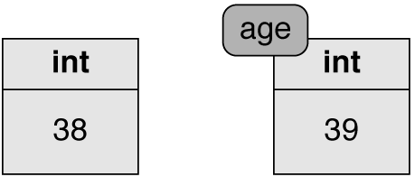
Diagram of age = age + 1

Slide 63
Numeric Operators
Syntax | Semantics
x + y | returns the sum of x and y.
x – y | returns the difference between x and y.
x * y | returns the product of x and y.
x / y | returns quotient of x by y. Int and long result in integer division.
x // y | returns integer division quotient of x by y in all cases.
x % y | returns quotient remainder of x by y.
x ** y | returns x raised to the y power.

Slide 64
Numeric Operators (continued)
Syntax | Semantics
-x | negation of x.
abs(x) | returns absolute value of x.
x += num | x becomes x plus num.
x -= num | x becomes x minus num.
x *= num | x becomes x times num.
x /= num | x becomes x divided by num.
x %= num | x becomes the remainder of x divided by num.

Slide 65
Numeric Operators (continued)
Syntax | Semantics
x == y | Returns True if x equals y else False.
x != y | Returns True if x not equal y else False
x < y | Returns True if x is less than y else False.
x <= y | Returns True if x is less than or equal to y else False.
x > y | Returns True if x is greater than y else False.

Slide 66
Numeric Operators (continued)
Syntax | Semantics
x >= y | Returns True if x is greater than or equal to y else False.
cmp(x, y) | x < y returns -1, x equals y returns 0, x > y returns +1.
round(val, num) | returns val formatted with num decimal places.

Slide 67
Casting
If legal, Python will convert from one type to another. Place type to convert to in front of the item to be converted in parentheses.
For example:
>>>int (3.6)
3
>>> str(3.6)
'3.6'

Slide 68
Casting (continued)
>>> list('hello')
['h', 'e', 'l', 'l', 'o']
>>> tuple(['h', 'e', 'l', 'l', 'o'])
('h', 'e', 'l', 'l', 'o')
>>> int('12a')
Traceback (most recent call last):
File "<pyshell#5>", line 1, in -toplevel-
int('12a')
ValueError: invalid literal for int(): 12a

Slide 69
Common Built-In Functions.
Syntax | Semantics
chr(num) | Returns ASCII character of num.
ord(character) | returns ASCII value of character.
max(sequence) or max(a,b,c,…) | returns the largest item in the sequence or parameters.
min(sequence) or min(a,b,c,…) | returns the smallest item in the sequence or parameters.
sum(sequence) | returns the sum of the sequence.
len(sequence) | returns number of items in sequence.

Slide 70
Common Built-In Functions
(continued)
Syntax | Semantics
range(stop) | returns list starting at 0 and upto but not including stop incrementing by 1.
range(start, stop) | returns list starting at start and upto but not including stop incrementing by 1.
range(start, stop, step) | returns list starting at start and up to but not including stop incrementing by step.
sorted(sequence) | returns sorted copy of sequence.

Slide 71
Modules
Python modules – found in Python libraries and contain less used functions.
Three ways to use functions found in a Python module.
from math import pi
print pi
import math
print math.pi
from math import * #brings in all methods
print pi

Slide 72
Commonly Used Modules
Name | Overview
math | math constants and functions.
random | classes and functions to generate random numbers.
time | functions to manipulate time.
datetime | classes to manipulate dates and time.
re | string regular expressions.
os | support for communicating with the operating system.
sys | functions and values for Python Interpreter.

Slide 73
Expressions
Can do multiple operations in one step – called an expression.
Functions can be called inside of an expression.
Order of operations same as in arithmetic:
  Function evaluation first.
  Parentheses next.
  Exponentiation (right to left).
  Multiplication and division (left to right order).
  Addition and subtraction (left to right order).

Slide 74
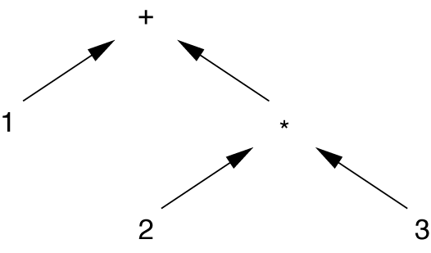
Evaluation Tree for Numeric Precedence
1 + 2 * 3

Slide 75
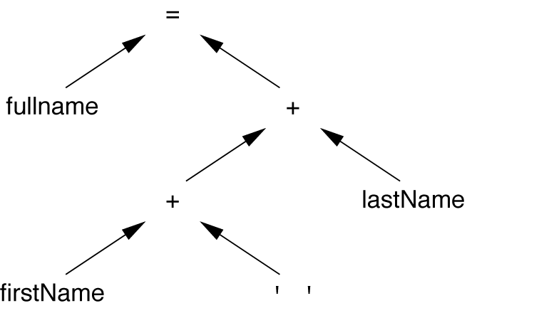
Evaluation Tree for Strings fullname = firstName+ ' ' + lastName

Slide 76
Boolean Class
Values are True and False.
3 < x and x < 8 can be written as 3 < x < 8
Boolean operation results shown on next slide.

Slide 77
Truth Table for Boolean Operations
X | Y | not X | X and Y | X or Y | X == Y | X != Y
False | False | True | False | False | True | False
False | True | True | False | True | False | True
True | False | False | False | True | False | True
True | True | False | True | True | True | False

Slide 78
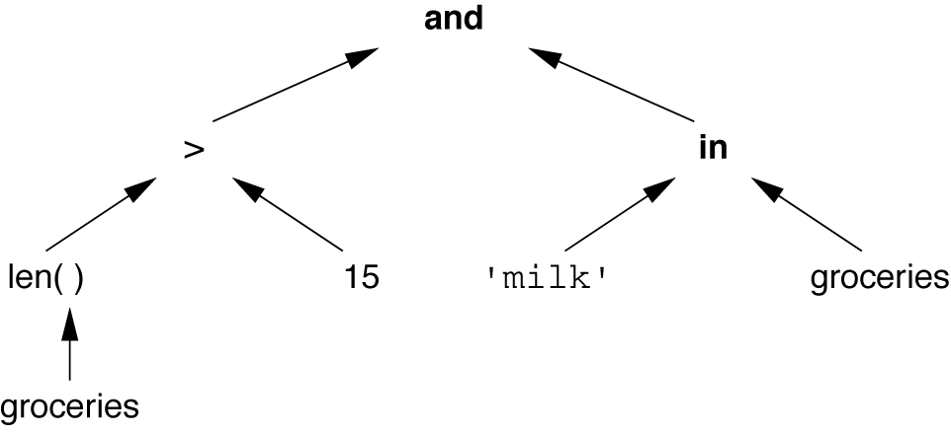
Evaluation Tree for len (groceries) > 15 and 'milk' in groceries

Slide 79
Comparing Shell Execution with Source Code in a File
Advantage/Disadvantage of statements in shell:
  advantage: executed immediately.
  has disadvantage: retype when it is to be executed again.
Source code in a file: advantage can be executed in several ways:
  Click on icon if in a windowing environment.
  Type file name in consol mode.
  Can execute easily within IDLE.

Slide 80
Source Code in a File
Source file should have a .py extension.
In the shell give command or object name to display output. Strings will have quotes when displayed.
Must use print to display information when in file. The print command will not display quotes for str's.

Slide 81
print and raw_input Commands
print can print multiple items just separate with commas.
print command automatically causes a new-line to be output at end of print.
print can do other new-lines by using '\n'
Use raw_input to enter data from keyboard into the source file.
  raw_input(string prompt)

Slide 82
raw_input(prompt)
raw_input(prompt) returns a string. Can convert to other types if necessary.
age = raw_input('Enter your age: ')
print 'Soon you will be', int(age) + 1
input(prompt) command returns a numeric value (int or float).

Slide 83
Case Study – Converting Date to a Different Format
months = ['Jan', 'Feb', 'Mar', 'Apr', 'May', 'Jun' 'Jul', 'Aug', 'Sep', 'Oct', 'Nov','Dec']
date = raw_input('Enter date (mm-dd-yyyy)')
pieces = date.split('-')
monthVal = months[int(pieces[0])]
print monthVal+ ' '+pieces[1]+', '+pieces[2]

